Slide 1

Using sentiment analysis to generate emotionally appropriate responses
Week 14 Mini Survey Luis Alberto Portilla López

Slide 2
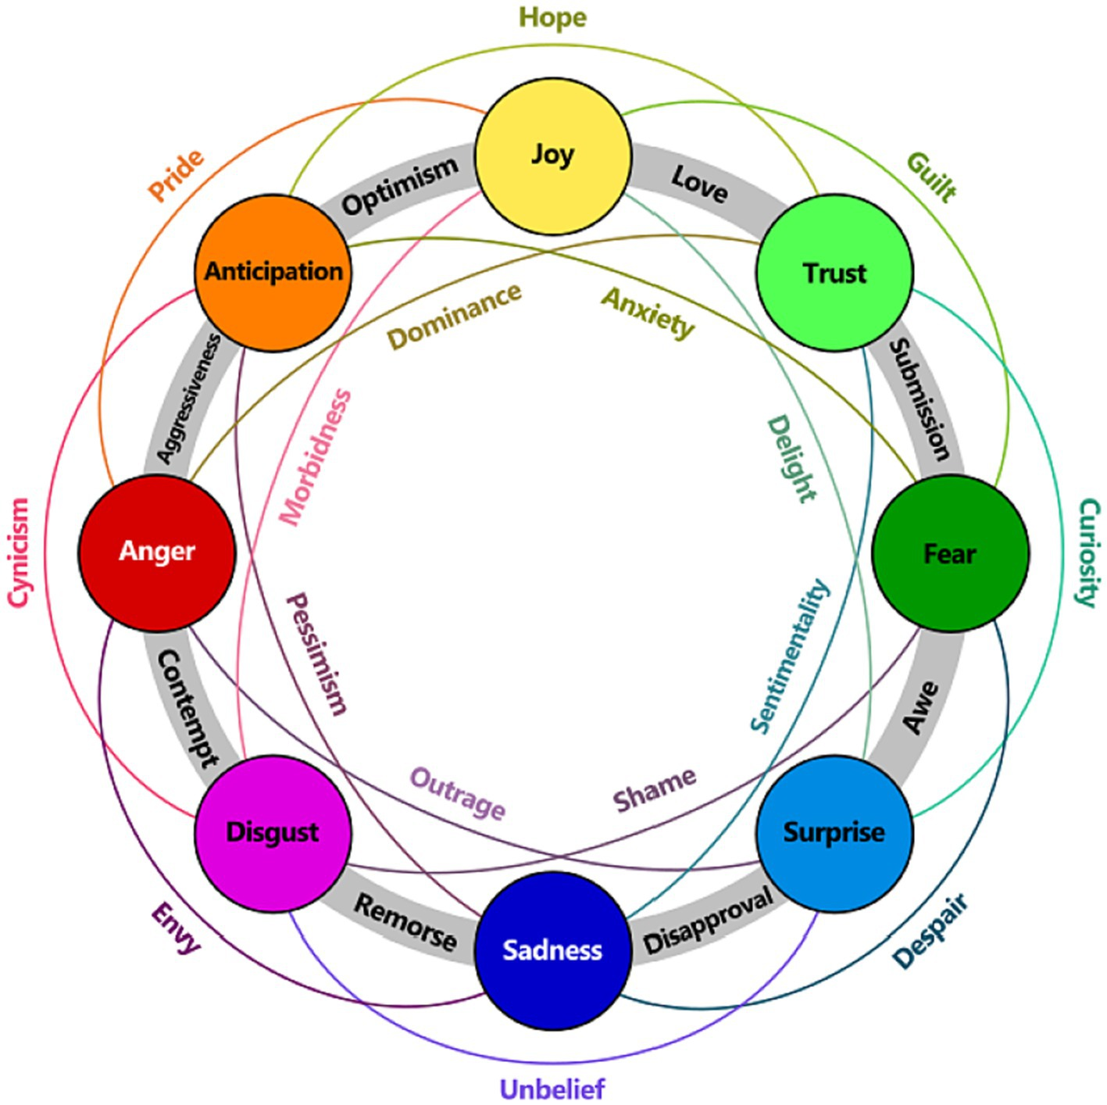
Emotionally appropriate responses
Being able to correctly classify emotions, and respond appropriately is paramount to a chatbots performance, often making or breaking the overall user experience

Slide 3
What problem it solves
• Chatbot Diversity and Accessibility: Creating chatbots for under-resourced languages or specialized domains using corpora
• Trust and Engagement: Enhancing user trust in chatbot systems by incorporating personalization and ethical considerations
• Broad Applications: Addressing evolving user needs across industries such as healthcare, education, and customer service

Slide 4
Challenges
Corpora Limitations:
Quality and structure of datasets heavily influence chatbot effectiveness.
Unstructured or noisy data can lead to poor conversational flows.
Trust and Bias:
Building trust in sensitive applications like healthcare and finance.
Ethical concerns over data privacy and personalization.
Technological Gaps:
Balancing rule-based and machine learning systems for optimal performance.
Addressing biases inherent in historical datasets.

Slide 5

Search Methodology & Criteria
Keyword Search
Boolean Search
Citation Chaining and Forward Citation
CRITERIA:
• Initial review of abstracts to assess relevance based on the title, publication venue, and year.
• Direct and indirect relevance to the paper being cross-referenced through the abstract.
• Consideration of the number of citations and field-weighted citation impact (fwci), a metric that measures the citation impact of a paper adjusted for disciplinary differences.

Slide 6

Preliminary Terms
Key terms identified during the week:
Corpus
• Trust
• Retention Rate
• Personalization

Slide 7

Document Comparison
“Using Corpora in Machine-Learning Chatbot Systems”
“An Overview of Chatbot Technology”
“In Bot We Trust: A New Methodology of Chatbot Performance Measures”
“ASEM: Enhancing Empathy in Chatbot”

Slide 8
Characteristic | Using Corpora in Machine-Learning Chatbot Systems | An Overview of Chatbot Technology | In Bot We Trust: A New Methodology of Chatbot Performance Measures | ASEM: Enhancing Empathy in Chatbot
Primary Focus | Exploring the use of corpora to generate diverse, multilingual chatbot systems. | Comprehensive review of chatbot evolution, architectures, and applications. | Developing novel performance measures for chatbots, emphasizing trust and user satisfaction. | Improving chatbot empathy through sentiment and emotion modeling.
Key Methodologies | Automated learning of AIML categories from text corpora; Java-based learning program. | Discussion of rule-based, AIML-based, and machine-learning-driven chatbot approaches. | Combination of neuroscientific methods, text mining, and machine learning. | Specialized attention mechanism and emotion-aware embeddings.
Applications | Creating chatbots for multiple languages (e.g., English, Arabic, Afrikaans). | Applications in customer service, education, healthcare, and entertainment. | Chatbot performance in business contexts, particularly customer service and personalization. | Open-domain chatbots for empathetic user engagement.
Evaluation Metrics | Quantity of AIML rules generated; diversity of languages and conversational patterns. | Not explicitly defined; focuses on historical impact and practical applications. | Trust as a key metric; conversation length, retention rates, and personalization capabilities. | Emotion classification accuracy, BLEU scores, lexical diversity.

Slide 9
Characteristic | Using Corpora in Machine-Learning Chatbot Systems | An Overview of Chatbot Technology | In Bot We Trust: A New Methodology of Chatbot Performance Measures | ASEM: Enhancing Empathy in Chatbot
Datasets or Corpora | British National Corpus (BNC), Qur'an Arabic-English Corpus, Minnesota French Corpus. | Historical examples like ELIZA, PARRY, and modern tools (e.g., Siri, Alexa). | Chatbot logs from various sources; proprietary tools like Tribefinder for text analysis. | Empathetic Dialogue Dataset (ED) and DailyDialog (DD)
Strengths | Efficiently automates chatbot creation for under-resourced languages. | Covers broad ground and highlights key advancements in chatbot technology. | Introduces trust as a critical performance measure, linking ethics to chatbot evaluation. | Enhances empathy in chatbots, reduces emotion-class confusion.
Limitations | Limited to the quality and structure of corpora; struggles with unstructured dialogue formats. | Lacks depth in technical evaluation; broad coverage sacrifices detail in methodologies. | Primarily focuses on trust and business applications, less on general chatbot use cases. | Large model size, high training requirements, dataset limitations.

Slide 10
References
• Abu Shawar, B., & Atwell, E. (2007). Using corpora in machine-learning chatbot systems. International Journal of Corpus Linguistics, 12(4), 489-516. https://doi.org/10.1075/ijcl.12.4.07sha
• Adamopoulou, E., & Moussiades, L. (2020). An overview of chatbot technology. Artificial Intelligence Applications and Innovations (AIAI), IFIP Advances in Information and Communication Technology, Springer, 554, 373-383. https://doi.org/10.1007/978-3-030-49186-4_31
• Przegalinska, A., Ciechanowski, L., Stroz, A., Gloor, P., & Mazurek, G. (2019). In bot we trust: A new methodology of chatbot performance measures. Business Horizons, 62(6), 785-797. https://doi.org/10.1016/j.bushor.2019.08.005
• Hamad, O., Hamdi, A., & Shaban, K. (2024). ASEM: Enhancing empathy in chatbot through attention-based sentiment and emotion modeling. arXiv. https://arxiv.org/abs/2402.16194

